Slide 1
Session on PYTHON PROGRAMMING
Aug 2021
Purva Deshmukh
Honeywell Internal

Slide 2
AGENDA
Introduction to Python Programming Language
Why is Python Popular?
Features of Python Programming language
Where is python programming used in Industry?
Python Installation
Python Vs Other Programming Language
Python Libraries and its usage
References

Slide 3
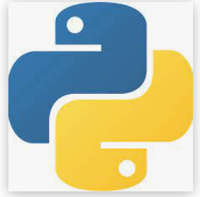
Introduction to Python Programming Language
Python is one of the most popular high-level, general-purpose programming language. It is interpreted, interactive and object-oriented programming language.
It is Open Source .We can download it from the website www.python.org and easy to install on different OS like Linux, Windows and MacOS.
It was founded by Guido van Rossum in 1989.

Slide 4

Why is Python Popular?
Despite having slow speed and performance issues as compared to other programming languages it is still popular because :-
Increasing Popularity of AI and Machine learning
and advancement in computational power
Simple programming syntax, code readability
and English-like commands
Large programming community and Excellent online documentation
Large number of Python Libraries and Frameworks
Easy to Learn for beginners.

Slide 5
Features Of Python
4
Simplicity and Open source
Portable
3. Rich set of Libraries and Framework
matplotlib for plotting charts and graphs
SciPy for engineering applications, science, and mathematics
BeautifulSoup for HTML parsing and XML
NumPy for scientific computing
Django for server-side web development
Embedded and Extensible
Interpreted Language
GUI Programming Support

Slide 6
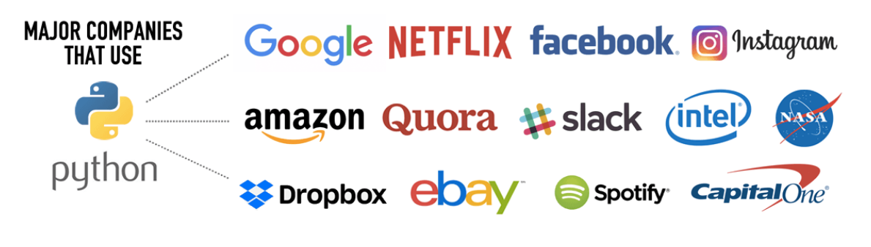
Where it is used in Industries?
The Python programming language is widely used by companies around the world to build web apps, analyze data, automate operations via DevOps and create reliable, scalable enterprise applications.
Netflix uses scipy and numpy for numerical computing to manage user traffic across the platform.
Companies such as Spotify, and Youtube collect user activity to make predictions and suggest playlists and videos. Scikit-learn and tensorflow are Python libraries that enable the use of algorithms
Facebook has published numerous open-source Python projects written for Py3 including a Facebook Ads API

Slide 7
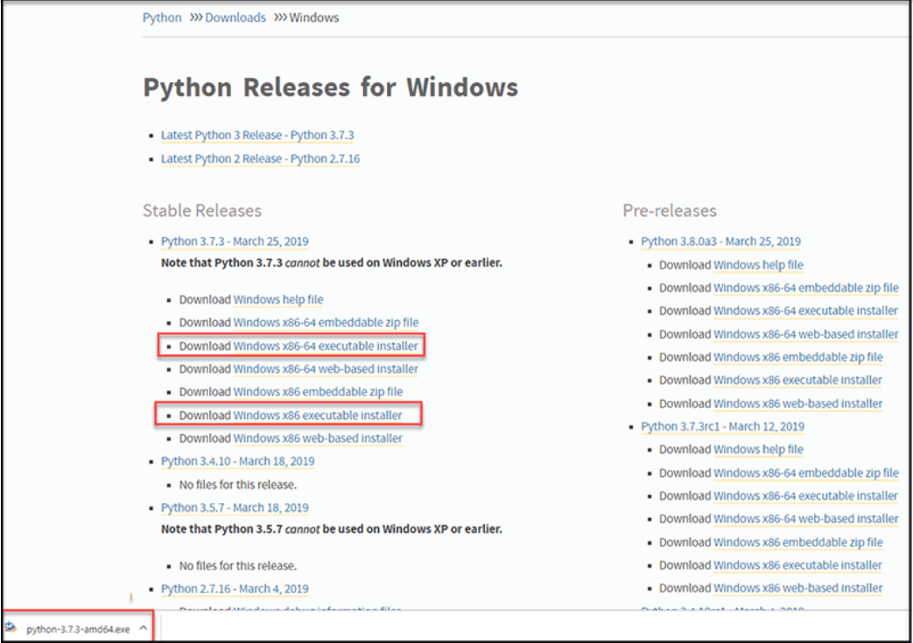
Steps To Install Python
Python can be Installed on Linux, Windows or MacOS Operating Systems.
Steps To Install Python Interpreter on Windows Machine:-
Open your web browser and navigate to the Downloads for Windows section of the official Python website. Download the latest version, or any other version from the links provided.

Slide 8
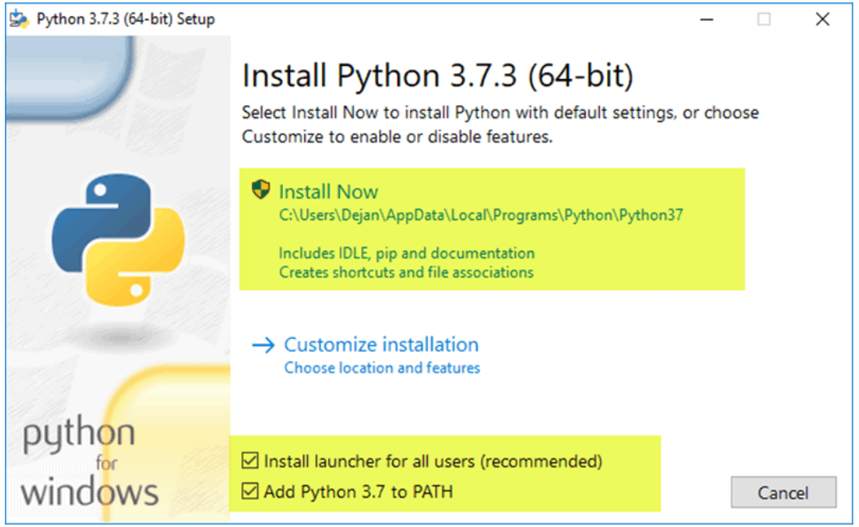
2. Run the Python Installer once downloaded. (In this example, we have downloaded Python 3.7.3.) 3. Make sure you select the Install launcher for all users and Add Python 3.7 to PATH checkboxes. The latter places the interpreter in the execution path 4. Select Install Now

Slide 9
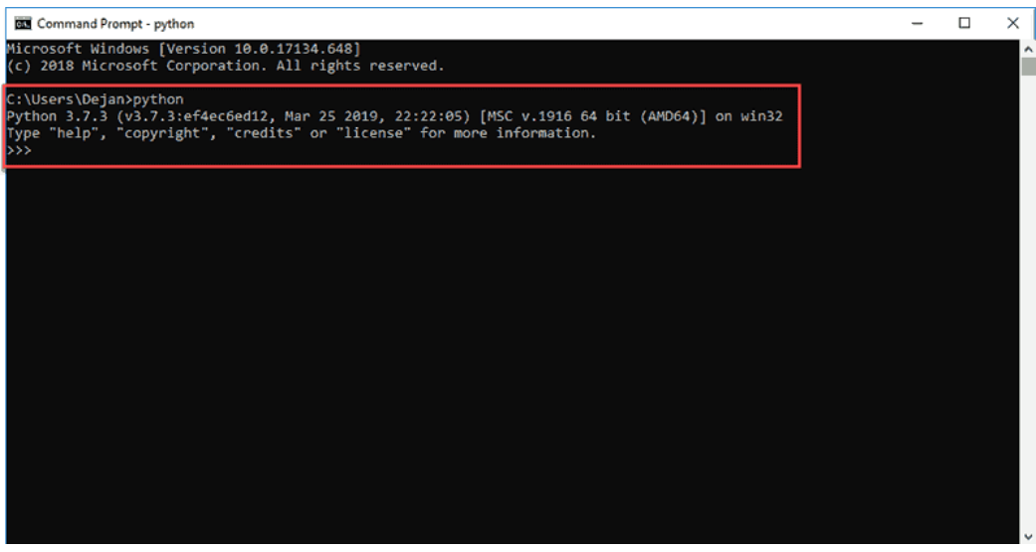
5. To verify If Python is installed successfully on your Machine open command prompt and type python. After command execution it will show python version which means it is correctly installed.

Slide 10
Installing Python IDE Python IDE (Integrated Development Environment) or code editor is a software tool which is used to edit and debug python code. There are many Python IDE’s available out of which the most popular one are 1. Visual Studio Code :- Official website: https://code.visualstudio.com 2. Pycharm :- Official website: https://www.jetbrains.com/pycharm/ 3. Sublime Text :- Official website: http://www.sublimetext.com/ 4. Atom IDE :- Official website: https://atom.io/ 5. Spyder Juptyer notebook:- Official website: https://github.com/spyder-ide/spyder

Slide 11
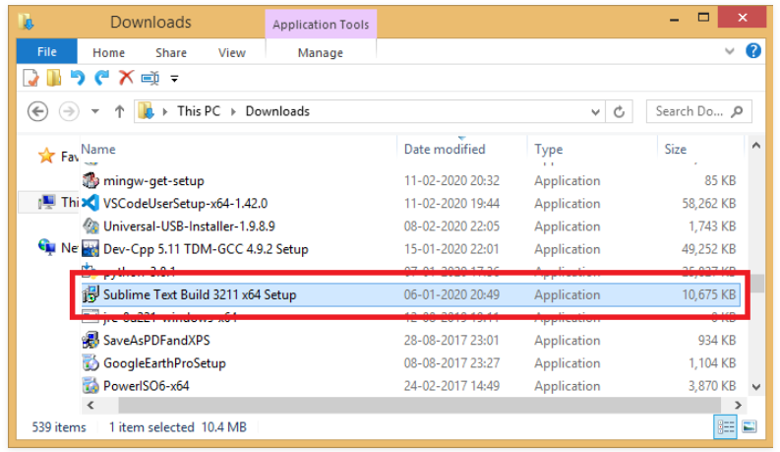
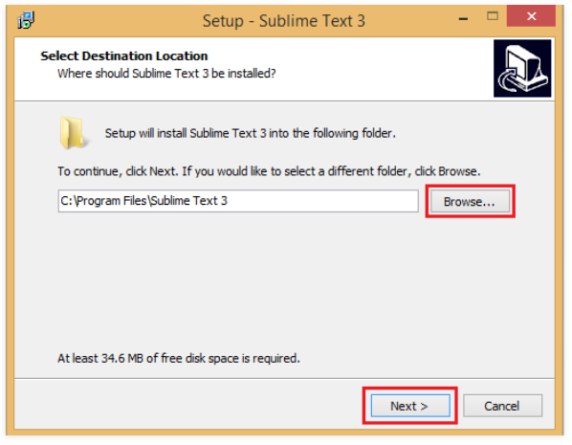
To install sublime text 3 on Windows 1. Sublime Text 3 can be downloaded from its official site sublimetext.com. Open the downloaded .exe file from the downloads folder and begin with the installation process. 2. Select the desired location and click on the next button to start installation

Slide 12
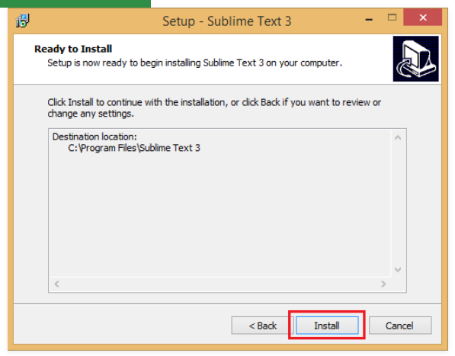
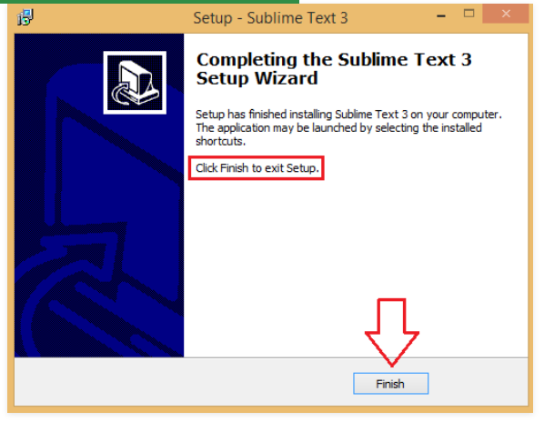
3. Press the install button.
4. Finish with the installation process.

Slide 13
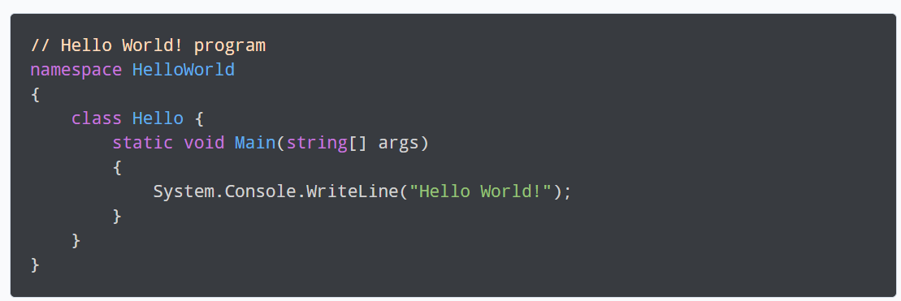

Python Vs Other Programming Language
To print “Hello World” in dotnet
To print “Hello World” in python

Slide 14
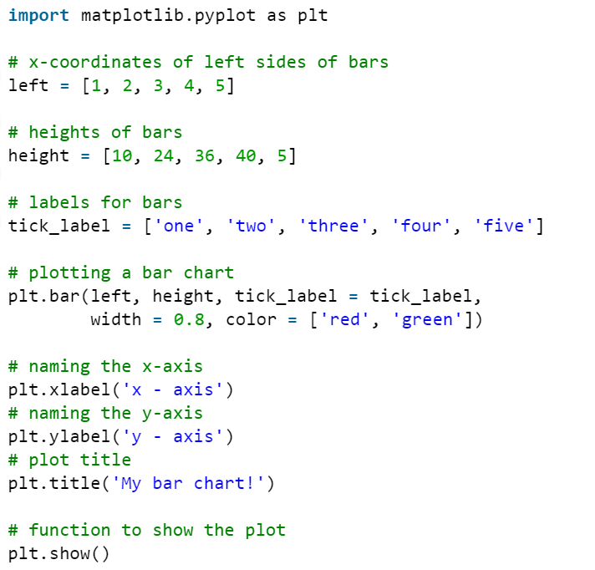
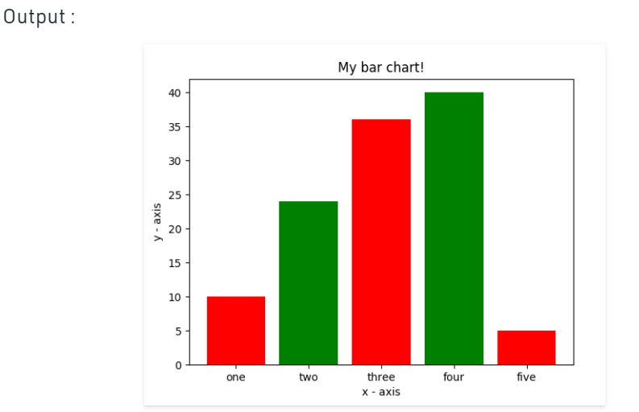
Python Libraries and its usage Example of a python program to plot graphs using matplotlib library in python. 1. Install matplotlib library using the following command in command prompt 2. Open an IDE and type the following code :
pip install matplotlib

Slide 15
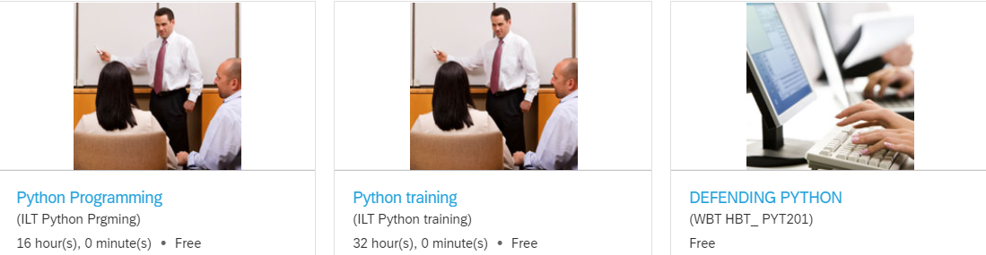

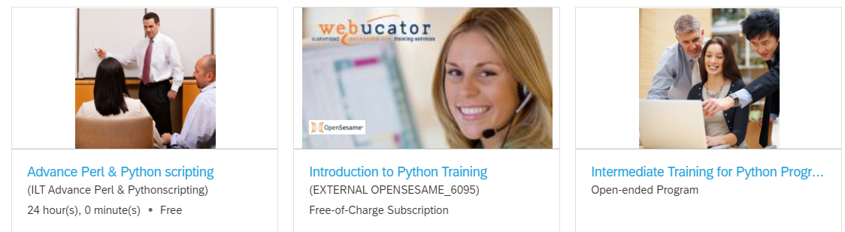
Honeywell Learning Hub References
Digital Workplace > Human Resources > Learning Hub > My Learning > Find Learning > Search “Python” > Go

Slide 16
External References https://www.youtube.com/watch?v=_uQrJ0TkZlc&vl=en https://www.youtube.com/watch?v=rfscVS0vtbw&vl=en https://www.geeksforgeeks.org/python-programming-language/learn-python-tutorial/ https://www.youtube.com/watch?v=YYXdXT2l-Gg&list=PL-osiE80TeTskrapNbzXhwoFUiLCjGgY7

